Slide 1
Mule Essentials

Slide 2
What is an esb?

Slide 3

Point to Point Communication

Slide 4
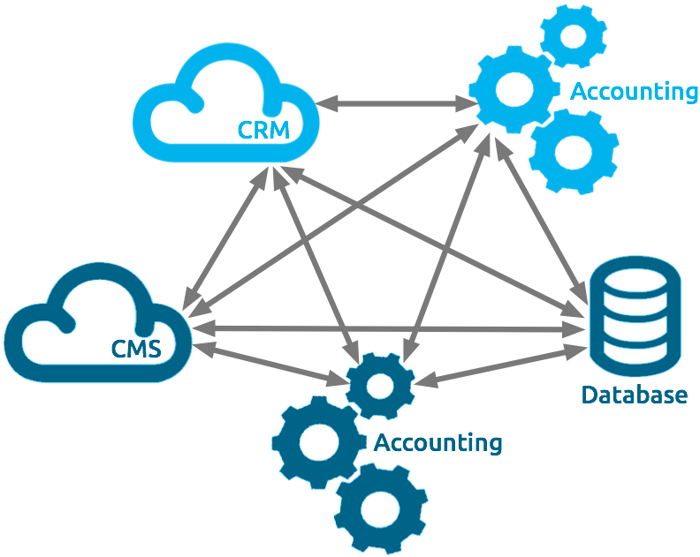
Point to Point Communication

Slide 5
What is an ESB?
ESB is fundamentally an architecture
It is a set of rules and principals for integrating numerous applications together over a bus-like infrastructure.
The concept of the ESB architecture is that you integrate different applications by putting a communication bus between them and then enable each application to talk to the bus.

Slide 6
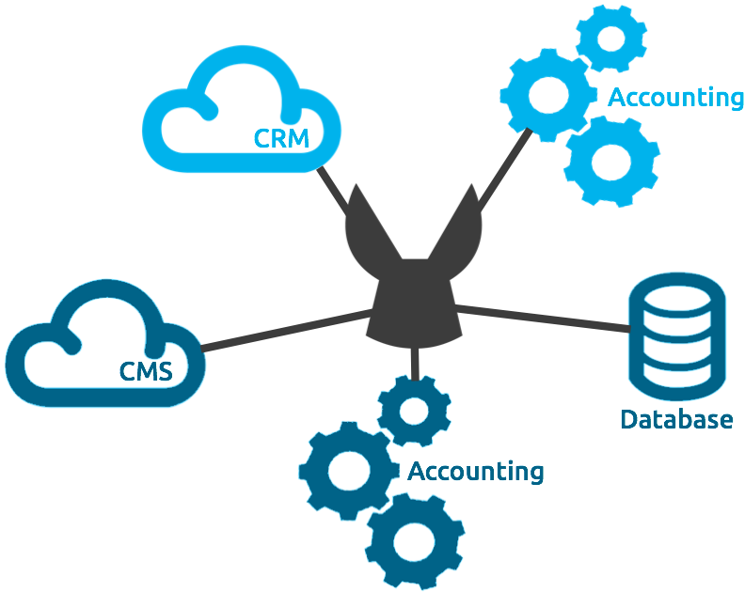
Using ESB

Slide 7
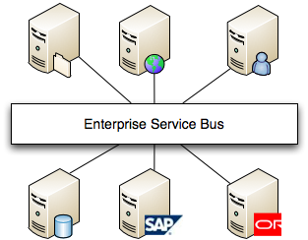
ESB

Slide 8
Why ESB?
Using ESB decouples systems from each other, allowing them to communicate without having a dependency or knowledge of other systems on the bus.
The data that travels on the bus is a canonical format.
There is an ‘Adapter’ between the application and the bus that marshals data between the two .
The adapter can also perform a host of other activities such as message routing, transaction management, security, monitoring, error handling, etc

Slide 9
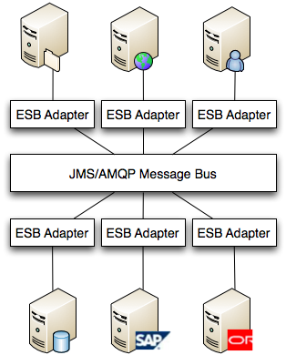

Slide 10
Where is BUS?
So, Bus is as set of queues through which data can be sent and received
Typically an application adapter will have an inbound and outbound queue to receive and send messages

Slide 11
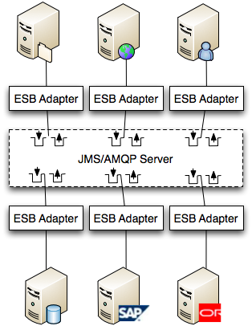
The ESB Adapter is really where a lot of the magic happens.
This is where data marshaling, transformation, security, transaction management and mediation is handled.

Slide 12
Why Esb?
Better approach than point-to-point integration because the integration logic is decoupled from the applications managed in a container that provides
security,
transaction management,
reliability patterns and
crucial monitoring and tracking capabilities.

Slide 13
ESBs
IBM Websphere ESB
Tibco Active Matrix ESB
Oracle ESB
Sonic ESB
Microsoft BizTalk Server
Apache Service Mix
JBOSS ESB
Ws02 ESB
MULE ESB

Slide 14
Introduction to mule

Slide 15
What is Mule?
Mule is a
Java-based ESB
integration platform
allows developers to quickly and easily connect applications to exchange data following the SOA methodology.

Slide 16
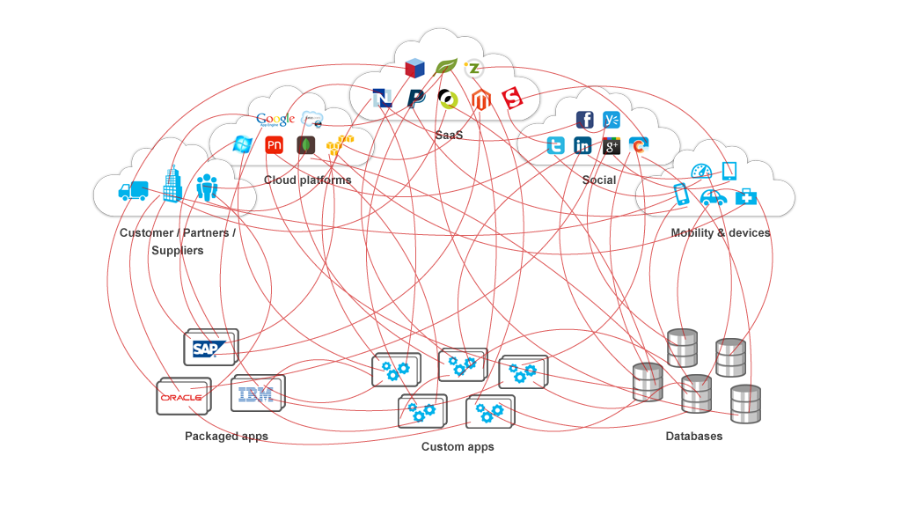
Why Mule?
Mule was developed to take the donkey-work out of integration

Slide 17
What is Mule ?
It is a messaging framework
Carries data between applications:
Uses a series of ‘stops’ or endpoints to send/receive data
Routing in Between
Data transformation between applications.
Logical Channel in Middle of Enterprise
Not a transport – like JMS

Slide 18
Orchestration
Application or service orchestration is the process of
Integrating two or more applications and/or services together to
automate a process, or
synchronize data in real-time.

Slide 19
Mule Basics

Slide 20
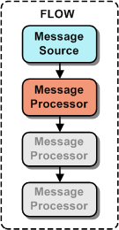
What is a Flow ?
Flow is a Message Source followed by a chain of message processors
Each processor is invoked in a sequence
Processors operate on message

Slide 21
What is a Message Processor?
Message processors are responsible for processing the received message.
These message processors are categorized by function:
Components: perform business logic & are typically application specific
Transformers: transform the message
Filters: accept/reject messages
Routers: control the message flow
Endpoints: send/receive messages over a transport

Slide 22
What is a sub flow?
Sub flow is a private flow which is not visible outside the current flow
A subflow will not have a Message Source.

Slide 23
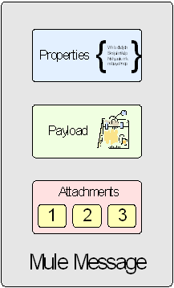
Mule Message
The Data received from an endpoint is packaged into an object that implements MuleMessage interface
A Message contains:
A series of properties that vary depending on the transport
Variables – Session and Flow
The data as the payload of the Mule Message.
If required, a series of attachments that can accompany the message.

Slide 24
What is a Mule Message Property?
A Mule message consists of
Properties
Variables
attachments and
a payload.
Message Property is a key value pair
A transport reads from a Mule message’s properties to populate an outgoing message’s header fields (e.g., HTTP)
A transport extracts an incoming message’s header fields and casts them into properties, which are added to the Mule message.

Slide 25
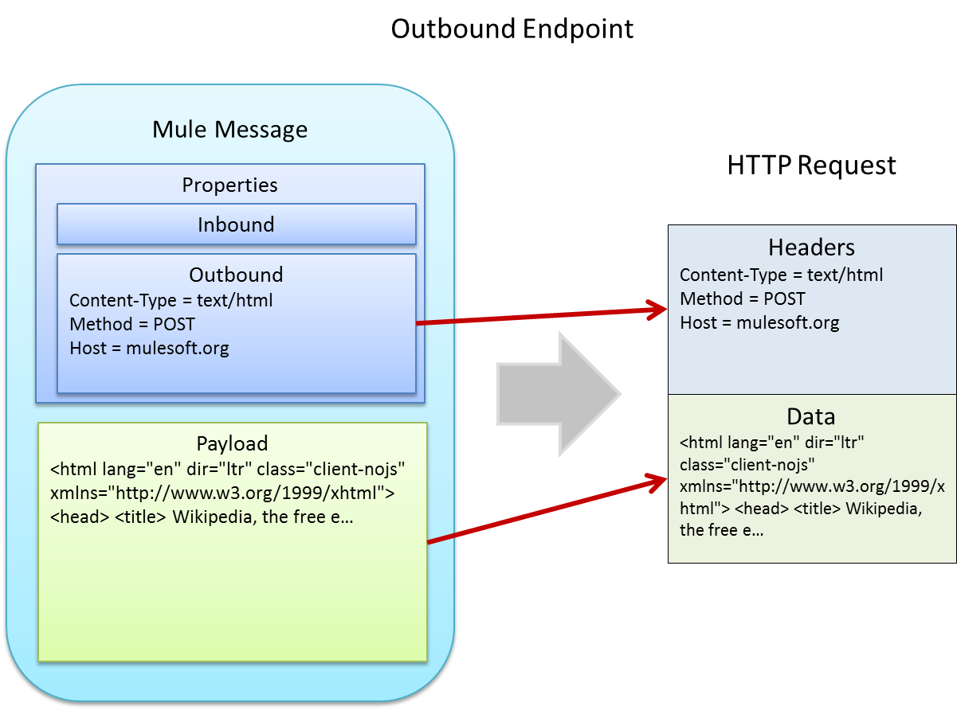
Mapping message headers to transport headers

Slide 26
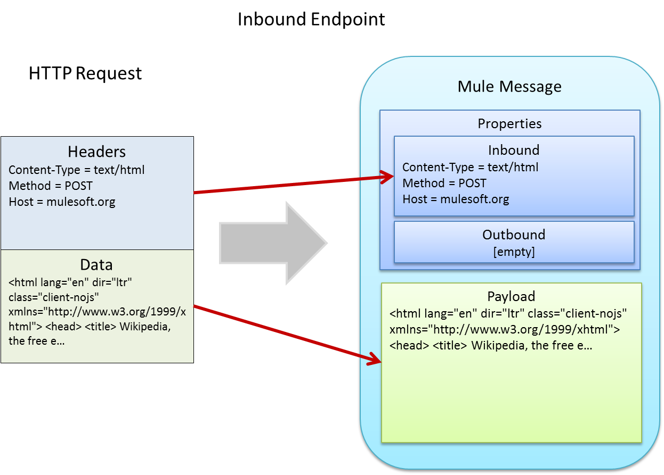
Mapping transport headers to message headers

Slide 27
What is a Transformer ?
The Message Transformer pattern allows components/applications using different data formats to communicate with each other.
Mule does not impose a specific message format so you can take advantage of whatever formats make the most sense for your application.

Slide 28
What is a Filter?
Filters are pass/fail.
They do not change the message in any way, but decide if the message should continue to be processed.
Three options can be taken in the case of a filter failing:
Ending the Message Processing immediately.
Re-routing the message elsewhere
Throwing an exception

Slide 29
What is an Endpoint ?
The Message Endpoint pattern allows you to connect different applications or objects to a messaging channel.
Each protocol (as a messaging channel) is transparently implemented meaning that the component does not know, or need to know, which protocol is being used to send or receive data.

Slide 30
Implement lab 1

Slide 31
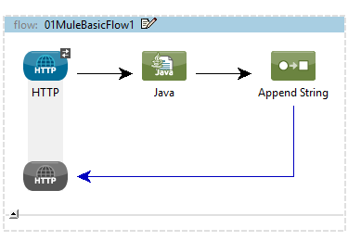
Lab
Implement the following flow :
Initialize Java component with PriceComponent

Slide 32
MEL Basics
In Mule We use Mule Expression Language (MEL)
We write Mule Expressions using the following syntax : #[]
message is an implicit object in MEL
message.inboundProperties and message.outboundProperties are maps using which we can access inbound and outbound properties
We can also use the following syntax for accessing any inbound property : #[header:inbound:inboundpropertyname]
We can access payload of message using #[payload]

Slide 33
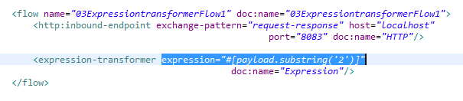
Expression Transformer
Expression transformer can be used to transform the payload

Slide 34
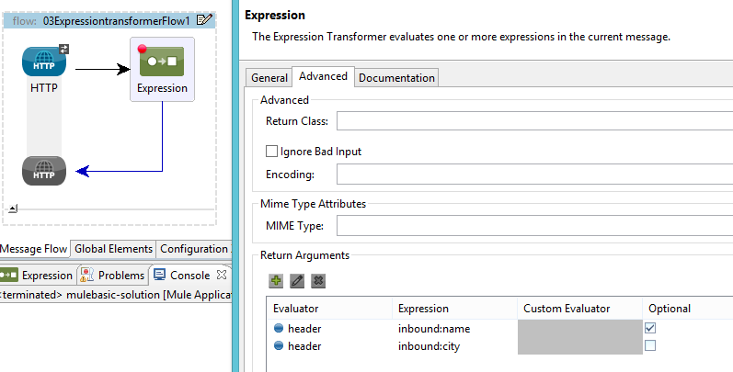
If u want expression transformer to return an array of arguments, u could do as below :

Slide 35
Entry point resolvers

Slide 36
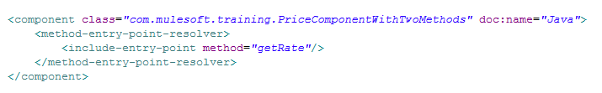
What if two or more conflicting methods are present in same class ?
Solution :
Use method end point resolver as below :

Slide 37
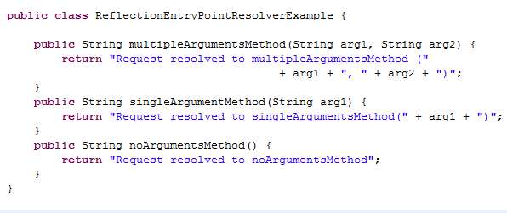
What if a method has to be invoked on your Java component based on method argument types and number of arguments based on reflection ?
Consider the following java class :

Slide 38
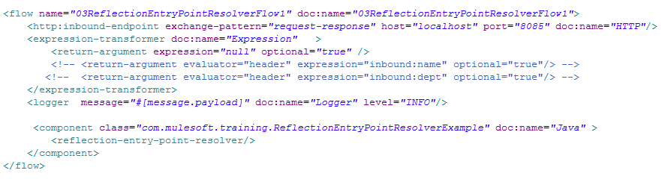
Solution : Use reflection-entry-point-resolver as below :

Slide 39
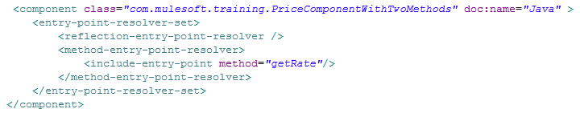
What if u want to use more than one entry point resolvers ?
Solution : Use <entry-point-resolver-set> as below :

Slide 40
What if u want to resolve the method to be invoked based on a property in message ?
Solution : Use <property-entry-point-resolver />

Slide 41
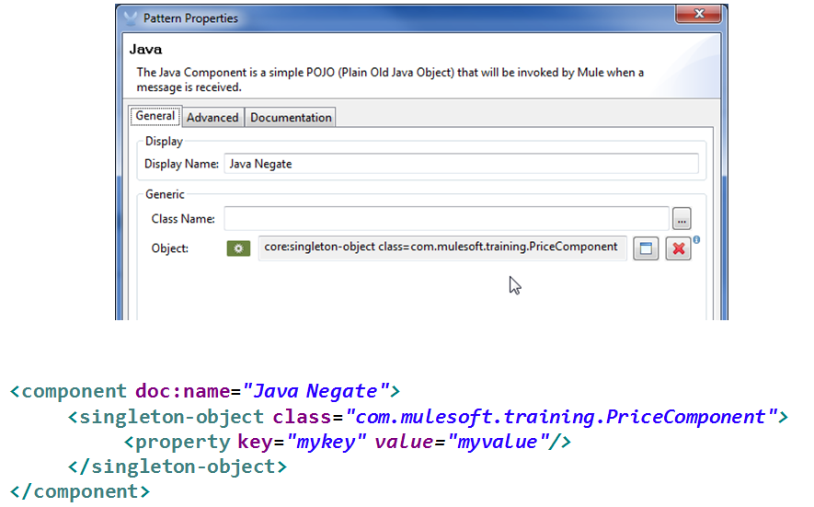
Defining a Singleton component

Slide 42
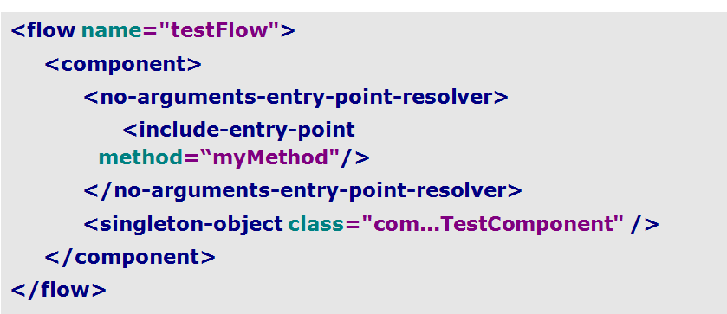
No-arguments-entry-point-resolver

Slide 43
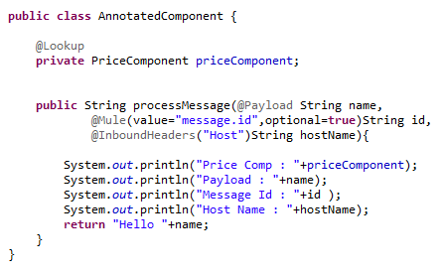
Annotations Example

Slide 44
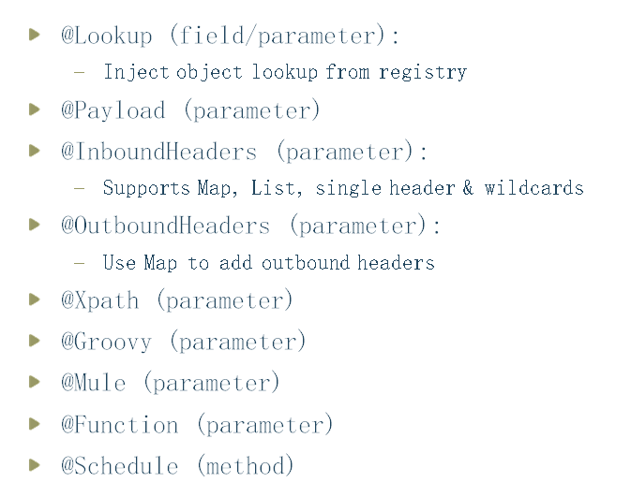
Available Annotations

Slide 45
Unit testing

Slide 46
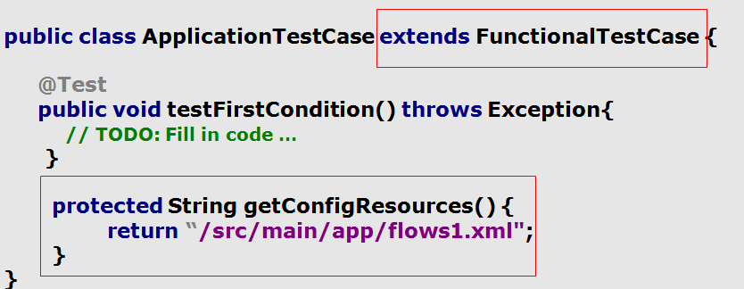
Example of test case

Slide 47
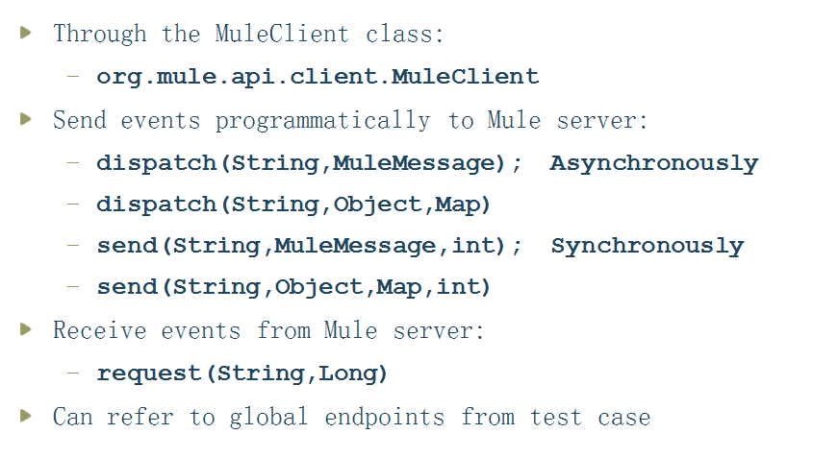

Slide 48
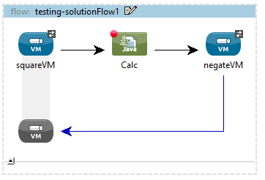
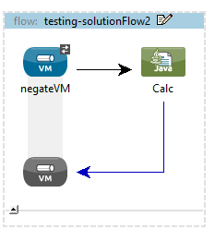
Sample Unit Test

Slide 49
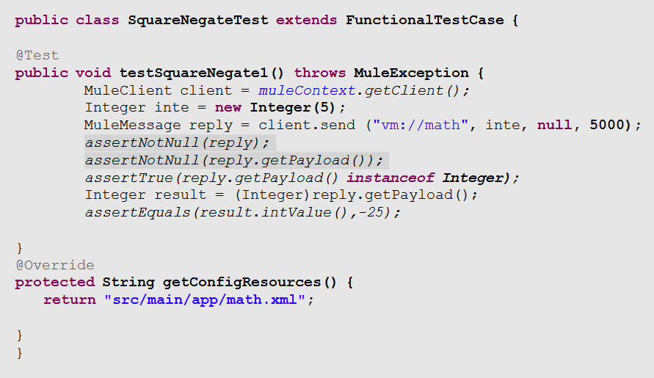

Slide 50
filters

Slide 51
What is a Filter?
Filters specify conditions that must be met for a message to be routed to a service or continue progressing through a flow.
Filters return null if the condition is evaluated to false. Otherwise, they return the message.
In the case of flows, a condition of false will halt the processing of the flow for that message.
If the inbound endpoint defined on a Flow has a request-response exchange-pattern and there are no <response> blocks in your flow then the response used is simply the result from the last Message Processor in the flow, which will be null.

Slide 52
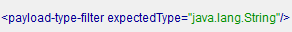
Payload Type Filter
Checks the class type of the payload object inside a message.

Slide 53
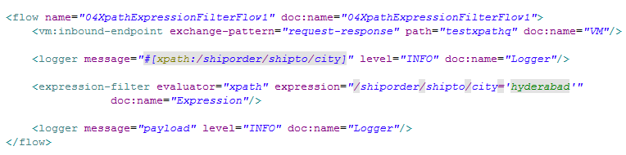
Expression Filter
Using XPath Expressions

Slide 54
RegEx Filter
Applies a regular expression pattern to the message payload.

Slide 55
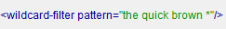
Wildcard Filter
Applies a wildcard pattern to the message payload.
The filter applies toString() to the payload

Slide 56
Exception Type Filter
A filter that matches an exception type.

Slide 57
Message Property Filter
This filter allows you add logic to your routers based on the value of one or more properties of a message.
This filter can be very powerful because the message properties are exposed, allowing you to reference any transport-specific or user-defined property

Slide 58
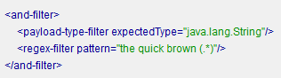
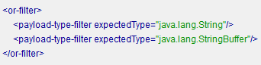
And Filter
OR Filter

Slide 59
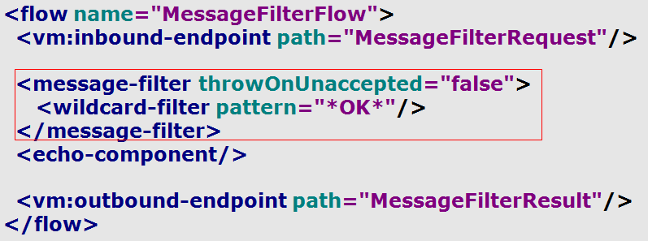
Message Filter
Message Filter defines
A single filter which consists of multiple filters that the message should match for it to continue progressing through a flow
What happens when message doesn’t meet the filter?
We can configure whether exception should be thrown or it should be redirected to a specific channel

Slide 60
Lab 3

Slide 61
MESSAGE PROPERTIES

Slide 62
What is a Mule Message Property?
A Mule message consists of
Properties
Variables
attachments and
a payload.
Message Property is a key value pair
A transport reads from a Mule message’s properties to populate an outgoing message’s header fields (e.g., HTTP)
A transport extracts an incoming message’s header fields and casts them into properties, which are added to the Mule message.

Slide 65
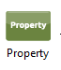
Property Transformer
The property transformer allows the user to change, manipulate and copy properties.
Set Property: Sets the specified outbound property to a value
Remove Property: Removes the specified outbound property
Copy Property: Copies the specified Inbound property to the same name Outbound property.

Slide 66
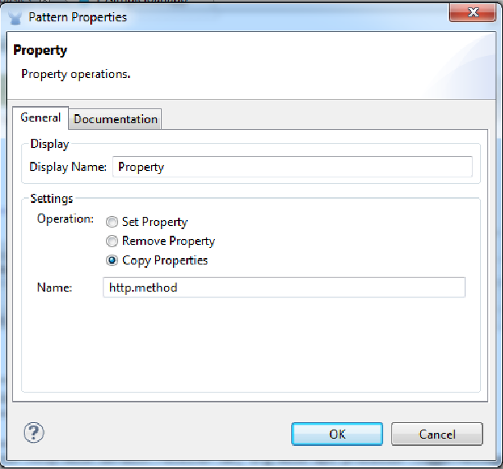

Slide 67
Lab 4 – using property transformer to copy inbound property to outbound property

Slide 68
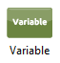
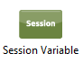
Variables are similar to properties but they are used by the developer to store information in the flow.
There are two type:
Flow Variable
Session Variable
is used to set a variable in flow scope
is used to set a variable in session scope

Slide 69
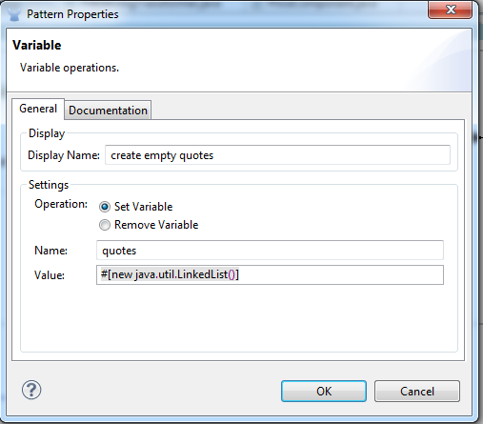
Example setting variable in flow scope

Slide 70
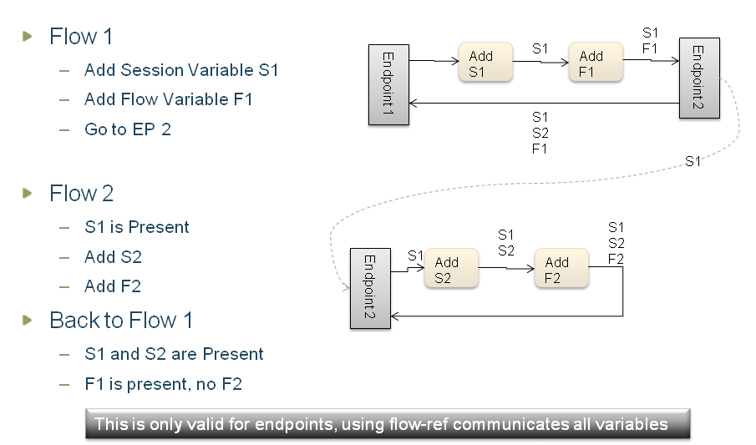

Slide 71
MEL

Slide 72
MEL Context Objects
Context objects provide logical groupings for the properties of the Mule message and its environment.
MEL has four context objects:
server: properties of the hardware, operating system, user, and network interface.
mule: properties of the Mule instance.
app: properties of the Mule application.
message: properties of the Mule message.

Slide 73
The default context object is message.
If you see #[payload], the message context object is implied.

Slide 74
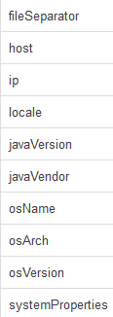
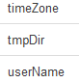
Server
This object provides read-only access to the properties of the hardware, operating system, user, and network interface listed in the table.

Slide 75
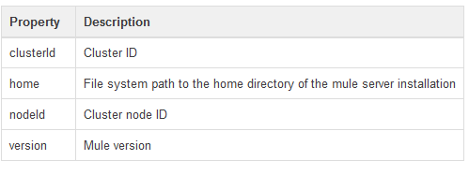
Mule
This object provides read-only access to the properties of the Mule instance listed in the table

Slide 76
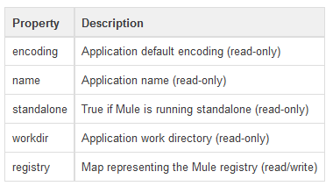
App
This object provides access to the properties of the Mule application listed in the table.

Slide 77
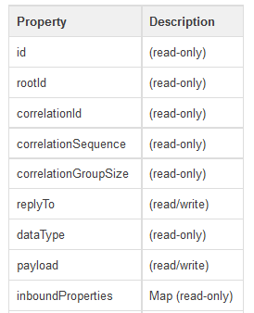
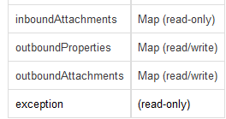
Message
This object provides access to the properties of the Mule message listed in the table.

Slide 78
Variables in MEL
flowVars and sessionVars are Maps and and can be accessed in MEL
If there is no local MEL variable called foo, the MEL processor looks for one in flowVars, then in sessionVars, before failing.
If the MEL expression contains foo == 'cat' and there is no local MEL variable named foo, but there is a foo key in flowVars, then the foo in the expression is equivalent to flowVars['foo'].

Slide 79
Xpath
The MEL xpath function allows you to evaluate XPath expressions. It has the following signatures:
xpath(xPathExpression) - applies the XPath expression to the message payload (an XML document) and returns the specified content.
xpath('/orders/order[0]') returns the first order from the message payload.

Slide 80
Xpath with element
xpath(xPathExpression, xmlElement) - applies the XPath expression to the XML element specified by the MEL expression appearing as the second argument and returns the specified content.
For example,
xpath('/orders/order[0]', message.inboundAttachment['order'])

Slide 81
Regex
regex(regularExpression)- applies the regular expression to the message payload. MEL processes as follows:
If there are no matches, return null Else if there is one match, return it. Else if there are multiple matches, return them in an array.
Eg: regex('^(To|From|Cc):') returns all lines of the payload that begin with To:, From:, or Cc:.
regex(regularExpression, melExpression) – using the same process as above applies the regular expression to the value of the MEL expression rather than the payload.

Slide 82
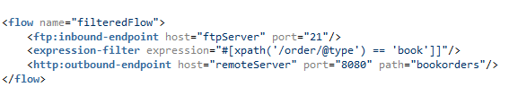
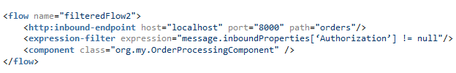
Examples using MEL in filters

Slide 83
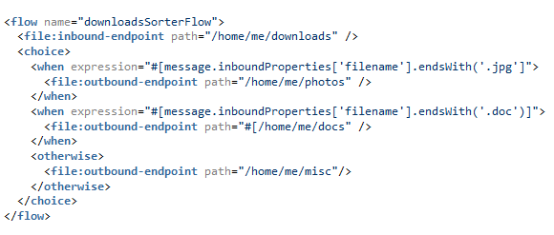

Slide 84
LIST AND MAPS IN MEL

Slide 85
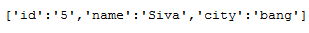
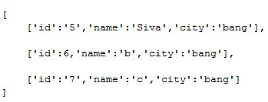
Creating Map in MEL :
Creating Array in MEL :

Slide 86
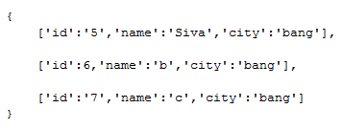
Creating a List in MEL

Slide 87
Choice Router

Slide 88

Choice Router

Slide 89

Message Properties in Mule API

Slide 90

MuleMessage methods (Properties related)

Slide 91
Custom Transformer
Your Custom Transformer has to implement Transformer Interface.
We generally extend AbstractTransformer and override doTransform() to write the transformation logic.
U can override initialise() for writing any initialising code

Slide 92

EXAMPLE CODE

Slide 93
LAB 5 –Implementing choice router

Slide 94

All Routing Pattern (Multicast)

Slide 95

All Routing Pattern

Slide 96
LAB 6 – IMPLEMENT ALL ROUTER

Slide 97
Splitter

Slide 98
Splitter
A message splitter can be used to break down an outgoing message into parts and dispatch those parts over different endpoints configured on the router.

Slide 99



Slide 100

Collection Splitter Example
How many times is Result logger executed in this case ?

Slide 101
In the Previous example, how to make sure that Result Logger is executed only once after all splitted messages are processed by
OrderProcessor
Solution : Use Collection Aggregator

Slide 102

Aggregator Pattern

Slide 103

Collection Aggregator

Slide 104
What is the result message type after Collection Aggregator is executed ?
Is it DefaultMuleMessage ?
No . It is DefaultMesageCollection.
DefaultMesageCollection is a collection of DefaultMuleMessage objects.
How to convert DefaultMesageCollection to DefaultMuleMessage with payload as List of payloads of individual messages ?
Use

Slide 105
Lab 7 – implement Collection Splitter

Slide 106

Splitter – Aggregator Example

Slide 107
The List Message Splitter router accepts a list of objects that will be routed to different endpoints.
The actual endpoint used for each object in the list is determined by a filter configured on the endpoint itself.
If the endpoint's filter accepts the object, the endpoint will be used to route the object.

Slide 108

Adds 3 message headers to each element
Correlation Id
Correlation Group Size
Correlation Number

Slide 109

Expression Splitter Router
This router is similar to the list message splitter router, but it splits the message based on an expression

Slide 110
LAB 7 SPLITTER AGGREGATOR

Slide 111

Async Wire tap

Slide 112

For Each

Slide 113

For Each Code Example

Slide 114
LOAN BROKER APP STEP BY STEP

Slide 115


Slide 116


Slide 117


Look up Credit Profile

Slide 118

Create Lookup banks subflow as below

Slide 119


Slide 120


Create 5 Bank Flows as follows

Slide 121

Look up loan quote subflow

Slide 122


Slide 123


Slide 124


Slide 125

Find Lowest Quote Flow

Slide 126

Find Lowest Quote Flow

Slide 127
http transport

Slide 128

Http Transport

Slide 129

Http Custom Properties

Slide 130

Http Content Type

Slide 131

Http Polling Connector Example

Slide 132
Https in mule

Slide 133

Generating keystore
We will use keytool in JDK to generate keystore which store the private and public keys.
Gave Keystore passwd as server
Gave password for alias serveralias1 as serveralias1

Slide 134

How to list the certificates from a keystore ?

Slide 135
How to export a certificte from keystore ?

Slide 136

How to import a certificate into truststore ?

Slide 137
Key Store
Key Store (tls-key-store in Mule): A keystore contains private keys, and the certificates with their corresponding public/private keys. You only need this if Mule is exposing an HTTP endpoint (server) .
In Mule, this is defined with the ‘tls-key-store’ attribute on the HTTPS connector.

Slide 138
Trust Store (tls-server in Mule): used as a repository of CA (certificate authority) or simple certificates that the should be trusted
This is used to store all the trusted client certificates
Note: this is only required u want the server to validate the client certificate also
In Mule, this is configured using the ‘tls-server’ attribute on the HTTPS connector.

Slide 139


Slide 140

Https Connector Configuration

Slide 141
LAB 8 – Implement Http polling and Https

Slide 142
File endpoint

Slide 143

File Transport

Slide 144

File Endpoint Example

Slide 145
Lab 9 – Implement file endpoint

Slide 146
JMS endpoint

Slide 147

JMS

Slide 148

JMS Queue

Slide 149

JMS Topic

Slide 150


Configuring JMS Connectors

Slide 151

Jms outbound endpoint example

Slide 152

JMS inbound endpoint

Slide 153

Back Channel

Slide 154

JMS Back Channel

Slide 155

Setting JMSReplyTo in flow

Slide 156

JMS BackChannel Example

Slide 157

JMS Single Resource Transactions

Slide 158
The rolled back message is eventually re-delivered to a service consuming from the queue.
we need to stop the message being rolled back after a certain number of tries.
Such messages are called ‘Poison’ messages and are controlled by configuring the ‘maxRedelivery’ on the JMS connector.

Slide 159
Exception handling in mule

Slide 160

Unhandled Message Exception

Slide 161
Errors that occur in Mule fall into one of two categories:
System Exceptions,
Messaging Exceptions.

Slide 162
System Exceptions
Mule invokes a System Exception Strategy when an exception is thrown at the system-level
System exception strategies handle exceptions that occur
during application start-up
when a connection to an external system fails
When a system exception occurs,
Mule sends an exception notification to registered listeners, logs the exception
If the exception was caused by a connection failure — executes the reconnection strategy

Slide 163

Messaging Exceptions
Mule invokes a Messaging Exception Strategy whenever an exception is thrown within a flow
When a message being processed through a Mule flow throws an exception, normal flow execution stops and processes transfers to the message processor sequence within the exception strategy.

Slide 164
Mule supports five types of messaging exception strategies
Default Exception Strategy
Catch Exception Strategy
Rollback Exception Strategy
Reference Exception Strategy
Choice Exception Strategy

Slide 165
Default Exception Strategy
Defined and implicitly applied by default to handle all messaging exceptions that are thrown in Mule applications
In case of transactions
When a message throws an exception, the default exception strategy rolls back the message and logs the exception.

Slide 166

Setting a strategy as default exception strategy

Slide 167

Xml Configuration of default Exception strategy

Slide 168
Catch Exception Strategy
Define a catch exception strategy to customize the way Mule handles any exception.
Catch exception strategies consume inbound messages.
In case of transactions
When a message throws an exception, the catch exception strategy always commits the transaction and consumes the message.

Slide 169


Slide 170
The Catch Exception Strategy preserves the message payload.
The payload received by the child message processor remains the same as it was before the exception was thrown.
In the Catch Exception Strategy context, the exception details are in the exception payload.

Slide 171

Configuring when in Catch Exception strategy

Slide 172
Rollback Exception strategy
Define a rollback exception strategy to ensure that a message that throws an exception in a flow is rolled back for reprocessing (if the message source supports redelivery).
Rollback exception strategies do not consume inbound messages.
In case of transactions
rollback exception strategy makes one or more attempts to rollback the message and redeliver it for processing (if the message source supports redelivery).
If the message exceeds its redelivery attempts, then the rollback exception strategy commits the failed transaction and consumes the message.

Slide 173


Slide 174

Reference Exception Strategy
Use a reference exception strategy to instruct a flow to employ the error handling behavior defined by a global rollback exception strategy.

Slide 175
Choice Exception Strategy
Define a choice exception strategy to customize the way Mule handles a message that throws an exception based on the message’s content
When a message throws an exception, the choice exception strategy makes a decision about where to route the message for further processing.
The choice exception strategy itself never actually performs any rollback, commit, or consume activities.

Slide 176

Choice Exception Strategy Example

Slide 177
JDBC

Slide 178
. A JDBC inbound endpoint maps to an SQL SELECT statement
JDBC outbound endpoint maps to an SQL SELECT, UPDATE, INSERT or DELETE statement

Slide 179

A SELECT on a JDBC outbound endpoint is triggered by a Mule event.
For example, this Mule event could have been created as a result of an HTTP request.

Slide 180

JDBC Connector Attributes

Slide 181

Configuring DB Connector and DataSource

Slide 182


Slide 183

Configuring Queries in DB Connector

Slide 184

JDBC outbound endpoint example

Slide 185
Jdbc inbound endpoint

Slide 186
Acknowledgement queries are executed immediately after a read query.
This type of query is identified with the same name as the read query together with an '.ack' suffix.
An acknowledgement query is normally used to mark the previously selected rows as having been processed or consumed.
This type of query is usually an UPDATE statement.

Slide 187


Slide 188
Soap endpoint

Slide 189

How to host a CXF Webservice

Slide 190


Slide 191

Consuming CXF Webservices

Slide 192

Simple CXF Client Example

Slide 193

Building JAX-Ws CXF Webservice

Slide 194



Slide 195

Mule Configuration for exposing Jax-Ws Webservice

Slide 196

Consuming Jax-Ws CXF Webservice

Slide 197


Slide 198

Cxf Webservice – WSDL First

Slide 199


Slide 200

Other Cxf attributes

Slide 201
Component life cycle

Slide 202

Component Life Cycle

Slide 203

Callable Example

Slide 204
Component binding

Slide 205

Component Binding

Slide 206



Slide 207



Slide 208
Custom transformer

Slide 209

Transformer

Slide 210

Abstract Transformer

Slide 211

Transformer - Example

Slide 212

Example

Slide 213


Slide 214
Custom filters

Slide 215

Custom Filters

Slide 216

Filter – Complex to Simple

Slide 217

Example

Slide 218

Filters - Mule Configuration

Slide 219

First Successful

Slide 220


Slide 221

Untill Successful

Slide 222


Slide 223
objectStore-ref:
Reference to the org.mule.api.store.ListableObjectStore that will be used to store events pending (re)processing.
deadLetterQueue-ref:
An endpoint or message processor to which undeliverable messages are sent after all retries have been attempted.
failureExpression:
Specifies an expression that when evaluated determines if the processing of one a route was a failure or not. If no expression is specified, only exceptions will be considered as processing failures.
secondBetweenRetries:
Specifies the minimum time interval between two process retries. The actual time interval depends on the previous execution but should not exceed twice this number.
maxRetries:
Specifies the maximum number of processing retries that will be performed.

Slide 224
Soap Webservice Security

Slide 225

Securing service using UsernameToken

Slide 226

Client Passing Username token

Slide 227

Service using signing

Slide 228

Client Using Signing

Slide 229


Delpoying Webapp in Jetty
Configure Jetty connector as below :
Create web applications under src/main/app/webapps

Slide 230

Web.xml
Configure web.xml as below :

Slide 231

Interacting with Mule from Your Code

Slide 232

Configuring servlet endpoint
Configure servlet endpoints as below :

Slide 233

Embedding Mule in a Webapp
Configure the following in web.xml

